Slide 1
Crash Course in Study Design
NIH Summer Student Researchers:
Stats and Design Refresher

Slide 2
Topics
Components of design
Statistical inference: the big picture
Common statistical tests

Slide 3

Components of design

Slide 4
Parts of a generalizable study
Research statement
Study design
Statistical methods

Slide 5
Research statement components
Population(s) of interest
Inclusion criteria: what defines the population?
Exclusion criteria: what factors may confuse interpretation of data or are contraindications for the intervention?
Intervention(s) or exposure(s) to use
What makes the intervention relevant to this population?
What (hypothesized) mechanism makes it plausible?
What changes should it produce?

Slide 6
Research statement components
Identify the construct(s) of interest
Construct = mental abstraction of an idea
Identify instrument(s) for each construct
Instrument = a specific way of measuring a construct
Justify instrument choices based on relationship between population, intervention, outcome of interest
Incorporate the pieces into your statement
Answers “who, what, how?” in general terms
The study design will fill in the details

Slide 7
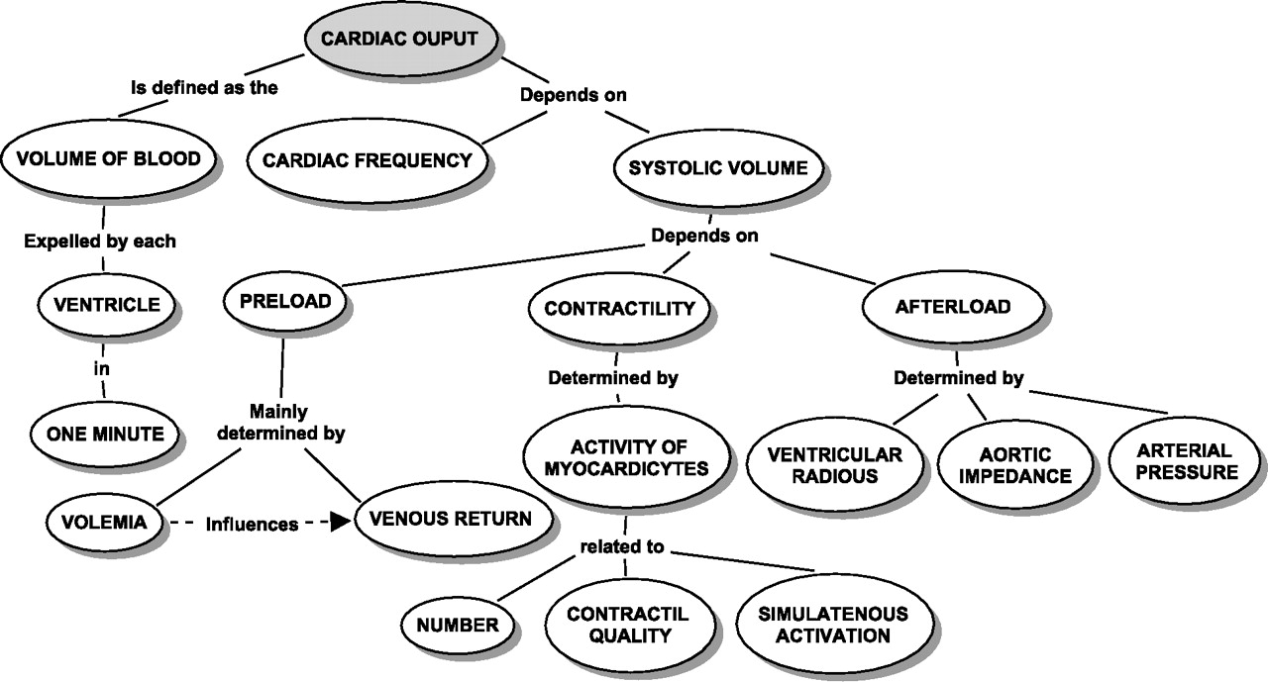
Concept Mapping
Displays relevant concepts & their relationships
Helps organize thinking about study design choices

Slide 8
Study design components
Subjects
Population of interest
Recruitment method
Variables measured
Identify concepts of interest
Identify suitable instruments for each concept: predictors and covariates
Number of and frequency of variable measurement

Slide 9
Study design components
Study arms
How many treatments? Dosage? Duration?
Will you use a control group?
Is treatment assignment fixed? (Crossover design or no?)
How many subjects?
How many subjects? A mix of:
Ease of recruitment & other practical concerns
Power analysis (statistical concerns)

Slide 10
Example: choice of instruments
Process
Identify the concept of interest
Identify potential instruments for each concept
Use concept map & established lit to choose instruments
Example
Construct: balance (vestibular or non-vestibular)
What are some possible instruments?

Slide 11
Example: choice of instruments
Vestibular balance
Dizziness Handicap Inventory, ABC Scale (and more)
Non-vestibular balance
Sit to Stand Test, 360 degree Turn Test, Berg Balance Scale (and more)
Some factors for choice of instruments
Existing literature (i.e. study replication?)
Aspects of balance relevant to the study intervention

Slide 12
Example statement: duration of rehab
Question: how long should rehab continue for?
Population(s) of interest:
Age 18+
0-3 months post-acute care discharge after lung transplant
Not currently on a chronic rehab plan, not exercising
Construct of interest: exercise capacity
Instrument: six minute walk distance (6MWD)

Slide 13
Example statement: duration of rehab
Intervention(s) or exposure(s) to explore
Goal: determine “best” length of in-patient chronic rehabilitation
Will the treatment given be specified exactly?
Is it “standard of care” or novel in some aspects?
Design will shape how this question is answered, e.g.
Compare 2 rehab time intervals? (7 wks. vs. 14 wks.)
Follow the group over time & measure outcomes weekly?
Compare novel rehab group to usual care (same duration)?
Rehab continues until a functional goal is reached?

Slide 14
Example statement: identify your aims
What questions are addressed by each design?
Option 1: compare rehab group to usual care?
“Is the standard of treatment useful at all?”
Option 2: study arms are 7 & 14 weeks of rehab
“Is there additional benefit from a second 7-week period of rehab?”
“Can standard treatment of 14 weeks be reduced to 7 to save time/money?”

Slide 15
Example statement: identify your aims
What questions are addressed by each design?
Option 3: follow the group over time & measure outcomes weekly
“Characterize how the population improves over time with rehab”
“When do they first see at least X amount of improvement?”
Option 4: follow the group until functional goals achieved
“[Goal] is a common reason for entering rehab in this group. How long does it take to achieve this goal?”

Slide 16
Construct example: dual-task exercise
Dual-task exercise (DTE)
DTE: exercise training in conjunction with cognitive tasks
Single-task exercise (STE) is exercise training only
Hypothesis: DTE better for balance than STE
Construct: balance
How to measure balance?
Mean sway velocity, sit-to-stand test, self-report of falls, etc.
Each choice captures some aspects of balance but not all
Choice of outcome affects your interpretation
Don’t equate outcome with construct!

Slide 17
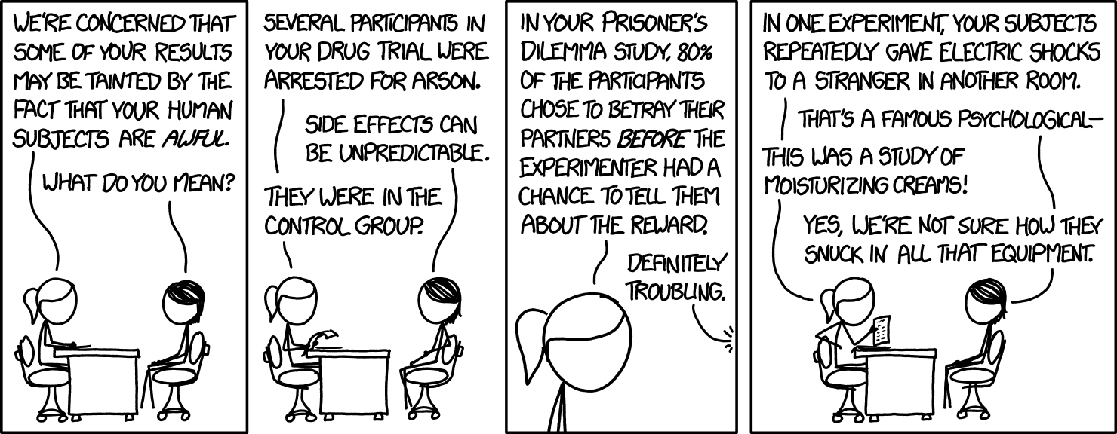
The control group

Slide 18
Design question: what is a control?
Study subjects who:
Resemble the intervention group at baseline
Do not receive the intervention
“What would happen if we hadn’t intervened in our treatment group?”
Purpose of control group
Separate treatment effect from natural history
Δ in controls ≈ natural history of population
Δ in treatment – Δ in controls ≈ effect of treatment

Slide 19
Types of control groups
Passive – “Do nothing” or placebo
Active – receive an established intervention
Historical – existing data from prior studies
Healthy – “intervention” is the disease present in the other study group; typical use is:
Baseline comparisons
Both groups receive same treatment/testing
Compare natural history in both groups

Slide 20
Example: choosing a control group
Vibration Training study, two hypothesis options:
Aim 1: VT is an effective exercise technique
Aim 2: Comparable to existing options while being more convenient
Research aim affects type of control group needed
Aim 1: show benefits above and beyond natural history
Passive control group to capture natural history?
Healthy controls to see if treatment group “returns to normal”?
Aim 2: show similar benefits to other exercise treatments
Requires one or more active control groups

Slide 21
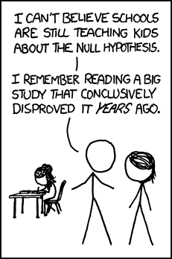
Statistical inference: the big picture

Slide 22
Before getting started
Get to know your data: exploratory data analysis
Graphing
Summary statistics
Purpose of EDA
Intuition: get a feel for the data
Flaws in data: identify unusual values
Outliers (that might be real)
Incorrect data (equipment malfunction, incorrect entry)

Slide 23
Statistical inference: NHST
Two components to statistical inference
Null Hypotheses
Significance Testing
NHST is modeled on scientific method
Attempt to falsify claims with evidence
True falsification is replaced by showing improbability
Be careful: falsifying one claim isn’t the same as proving a different claim is true

Slide 24
Basics of NHST: Null Hypothesis
Null is a claim about one or more parameters
Usually the total absence of [some] effect
e.g. NH assumes treatment effect is exactly zero
Null is assumed to be “true”
NH compared to an alternative hypothesis
Alternative is “not what null claimed” – isn’t a specific claim
Misnomer to say it is the alternative hypothesis

Slide 25
Basics of NHST: Significance Testing
Goal of significance testing
To formalize the process of making inferences from data
Inference is a process of generalization
1. Observe characteristics of sample
2. Significance testing step
3a. If ST confirms, infer that characteristics hold in entire population of interest
3b. If ST does not confirm, (usually) do not make any inferences at this time

Slide 26
Significance testing
Each statistical test has two components
Specific null hypothesis to be tested
Assumptions about population and variables used
Null hypothesis examples
Population mean is equal to [a given value]
Two distinct populations have equal standard deviations of scores on the instrument used
There is no linear relationship between two variables

Slide 27
ST example: effect of treatment
Example context
Want to estimate mean effect (improvement) from treatment
Have data from a sample of treated and controls
Mean effect in the sample is an estimate of mean effect across the whole population
How good is this estimate? Factors:
Is the sample representative of the population?
How large is the sample?
How precise are the measurements?
How much variation in effect was there between subjects?

Slide 28
ST output: p-values
P-value is a measure of how likely the data are if we assume two things are true:
Null hypothesis
Assumptions about population and variables from the test
Decision rule
With “sufficiently small” p-values reject the null hypothesis as implausible; infer that it doesn’t describe the population
Otherwise fail to reject the null hypothesis

Slide 29
“Sufficiently Small” p-value?
Significance level α
Infer that the null is false if p-value is smaller than α
In medical research usually set α = 0.05
Also called the false-positive rate (FPR) for that test
Test is statistically significant if p < α
Interpretation of significance at p = 0.05
If null hypothesis and ST assumptions are true, then 1 in 20 studies will have results at least as extreme as this
“As extreme” means how far it diverges from what null hypothesis predicted

Slide 30
Generalizability
What is it?
Degree to which inferences can be made to a population from statistically significant tests on a sample
Factors affecting generalizability
Sample size
Exclusion criteria imposed
Presence of confounding variables (unaccounted covariates)
Detectable effect size
Number of statistical tests performed

Slide 31
Generalizability: sample size
Why does sample size matter? An example
Estimate mean height of adult women in the USA
Some tall, some short people
Exceptionally tall or short people will skew the mean
In larger samples this will tend to balance out

Slide 32
Generalizability: exclusion criteria
Why do exclusion criteria matter?
Population of interest is defined by inclusion criteria
Exclusion criteria are used to remove confounding factors
Excluding some of the population makes sample no longer representative of its entirety
Confounding factor
A variable that changes the relationship between other observed outcomes of a study if not accounted for
Example: exercise training studies usually exclude smokers because smoking effects may confound benefits of training

Slide 33
Generalizability: detectable ES
Why does detectability matter?
There is a smallest treatment effect a study can detect as statistically significant
This lower bound depends on sample size, precision of measurement, and test used
If actual treatment effect is smaller then…
Either study will fail to detect anything
Or study will overestimate the true effect
If actual effect exists, neither of these is desirable

Slide 34
Generalizability: number of tests
Why does the number of tests performed matter?
Each test has a false discovery rate
Probability of at least one false discovery increases with each test performed
No way to know from one study which test(s) were false positives
Need to be able to explain all findings

Slide 35
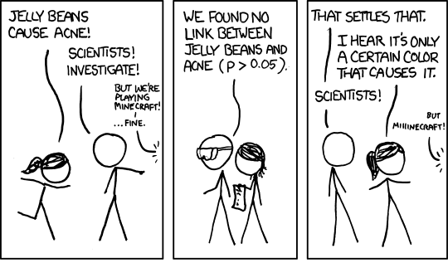
False Discovery, Act1

Slide 36
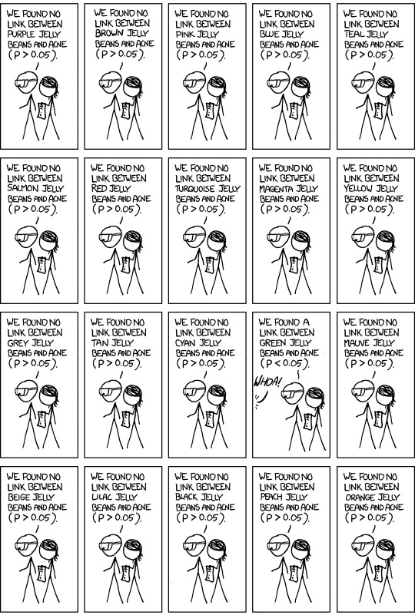
False Discovery, Act II

Slide 37
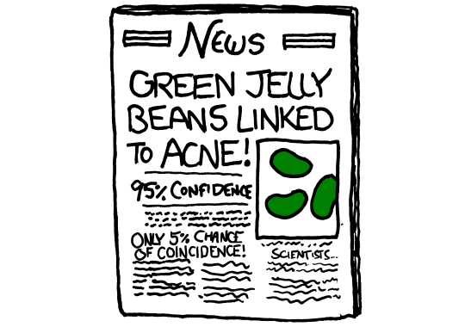
False Discovery, Act III

Slide 38
Two ways of handling false discovery
An issue when performing many tests
“Green jellybean problem”
Option: reduce significance level
Use smaller α based on number of tests performed?
Bonferroni method most common, Sidak slightly better
Option: control False Discovery Rate (FDR)
Benjamini-Hochberg “step up” method for k tests
Idea is to rank test p-values least to greatest p₁ to p_{m} and compare k^{th} p-value against (k/m)* α

Slide 39
Deeper issue with false discovery
Null is never exactly true
There will be some effect but could be tiny
Not scientifically interesting to pretend failure to reject means we have any belief true effect is exactly zero
More important to accurately estimate:
Sign of effect (benefit or harm?)
Magnitude of effect (estimate within factor of 10)
Underpowered studies risk having both of these errors

Slide 40
Common statistical methods
t test: compare difference in two means
Mean of treatment compared to control group
One group is compared to a null hypothesis value
Not appropriate for testing 3+ groups at once
ANOVA: analysis of variance
Compares differences in means in 2+ groups
If significant, conclude that at least one group has a mean different from at least one other group
Don’t yet know which group(s) differ
Is actually an example of linear regression

Slide 41
Common statistical methods
Linear regression
Uses a single outcome and 1+ predictor variables
Best fit line to predict outcome from independent vars
Example:
Heartrate Max = 220 – Age
Comes from a regression of HR on age in one study
220 and -1 are the regression coefficients for y-intercept and age
y-intercept is the predicted value when all predictors = 0
Interpreted as peak HR declines by 1 bpm per year of life, on avg

Slide 42
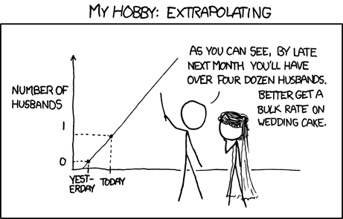
Common statistical methods
Linear regression
Don’t use regression to predict outcomes outside the observed range. This is called extrapolation

Slide 43
Common statistical methods
(Pearson) Correlation r
Strength of linear relationship between 2 variables
r = 0 – no linear relationship
r = 1 – perfect positive relationship
r = -1 – perfect negative relationship

Slide 44
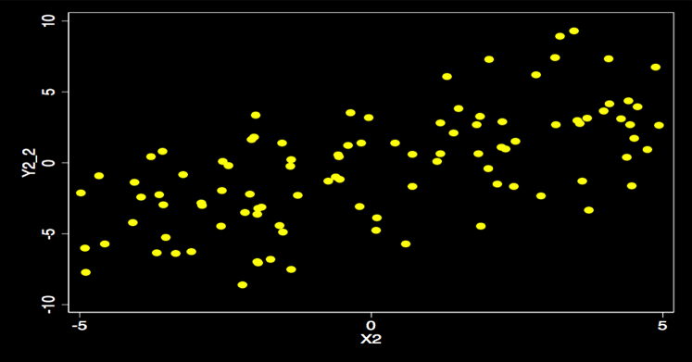
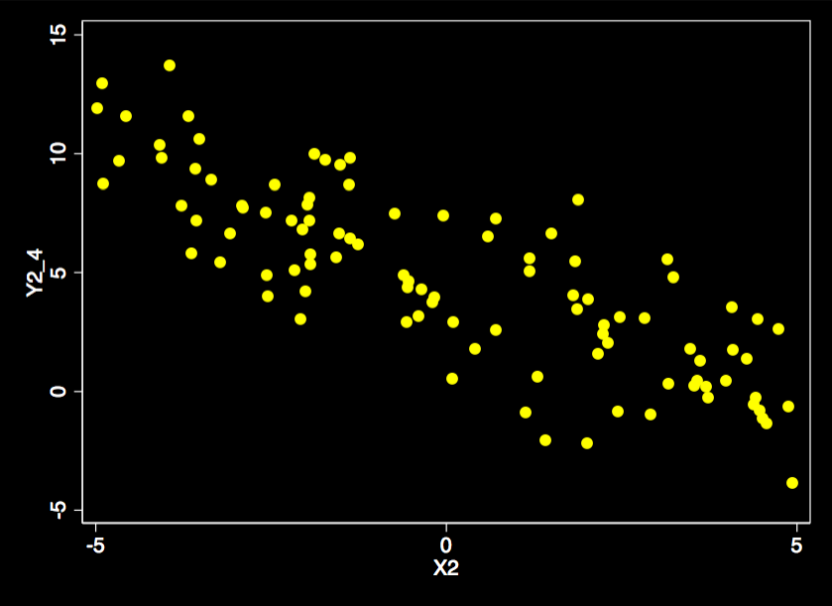
Common statistical methods
(Pearson) Correlation r
Left graph has r = 0.633, the right has r = -0.816
Can tell between them by trend (up/down) of data

Slide 45
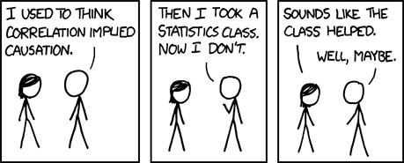
Conclusion

